Slide 1


SIX-WEEKS SUMMER TRAINING
presented by;
Karthik Korrayi
reg. 11912804
course code: CSE443

Slide 2




TRAINING PARTNER

Slide 3
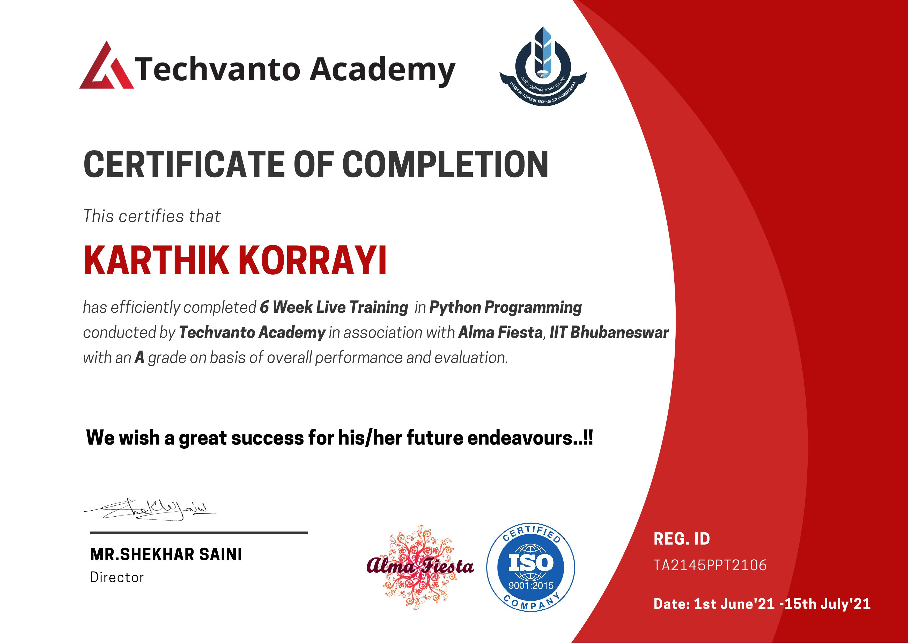
CERTIFICATE

Slide 4
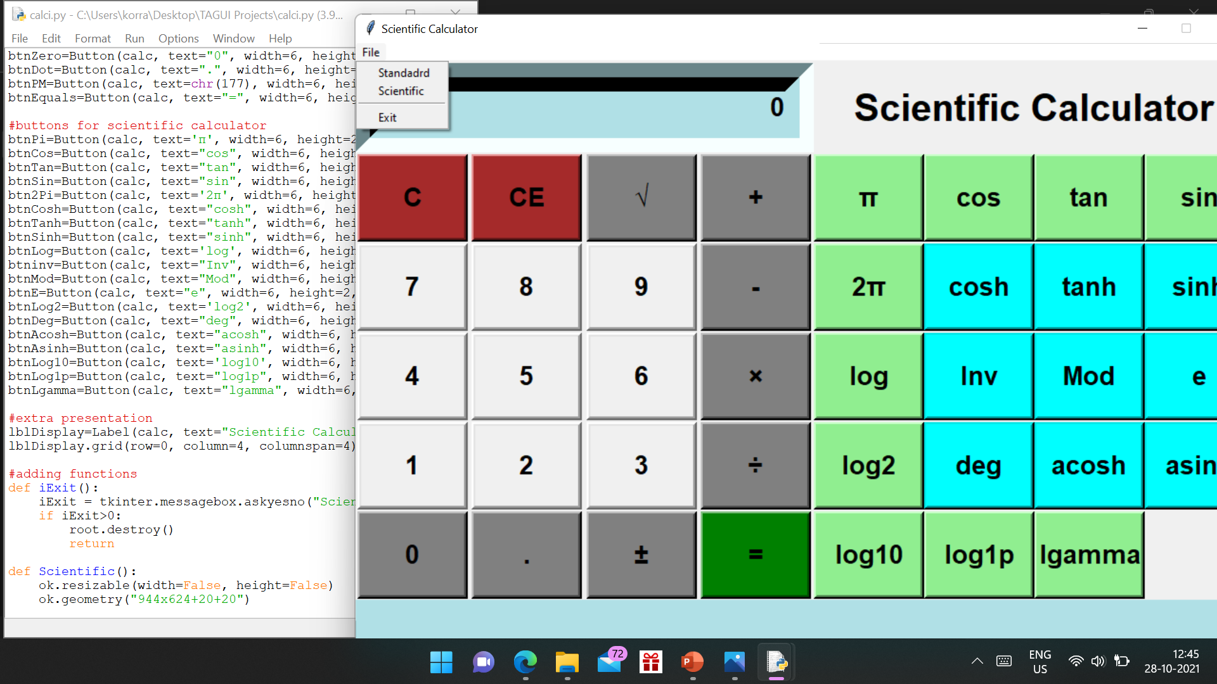
about
M ini-
PROJECT

Slide 5
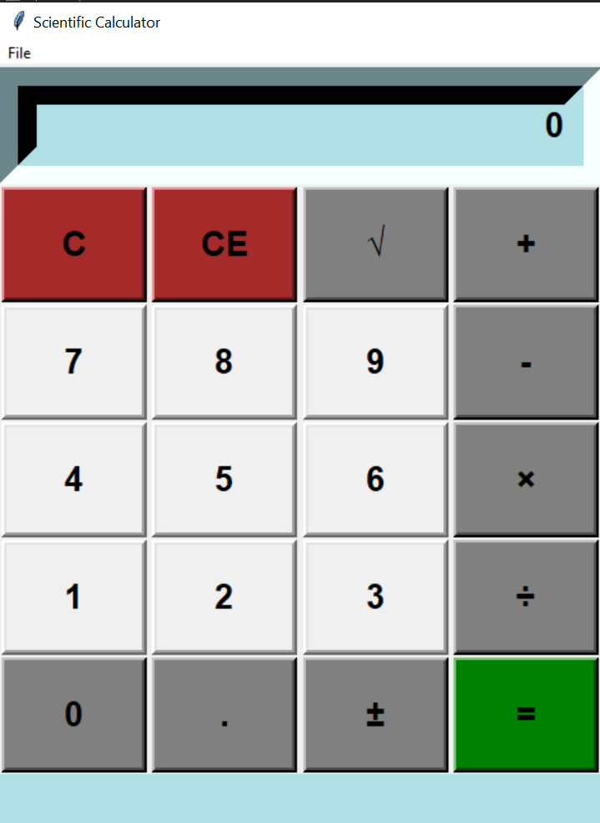
reason for choosing this Technology
This scientific calculator is used widely in situations.
It require quick access to certain mathematical functions.
Basic calculators are great for solving simple equations with one or two variables.
Scientific calculators allow us to input a problem that has an order of operations.

Slide 6
The project was developed in using Python Programming Language with Graphical User Interface.
It provides High-Level of reliability, availability, and compatibility.
The system is easier to handle and does not require special training to handle it.
Feasibility Analysis

Slide 7

Software requirement
Modern Operating System required minimum of windows 7 or 10 with 4GB RAM in minimum required i3 intel processors in 64-bit CPU as intel/AMD architecture or Linux-Ubuntu 16.04 to 17.10.
Required 5GB free disk space for Python latest version IDLE module document to write code (in my suggestion).
We can use PyCharm or Spyder software’s instead of Python IDLE, an open-source IDE for Python development.

Slide 8
Design
This python application is designed to calculate entered numbers to any operations.
It is also capable of handling all types of exceptions.
The design of this system is simple. so that the user won’t get any difficulties while working on it.

Slide 9
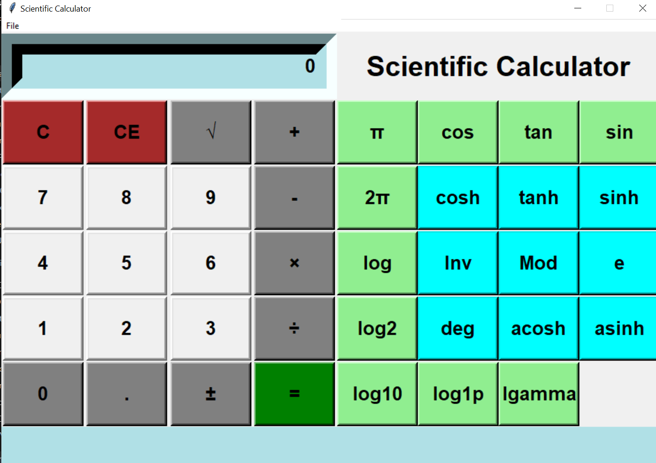
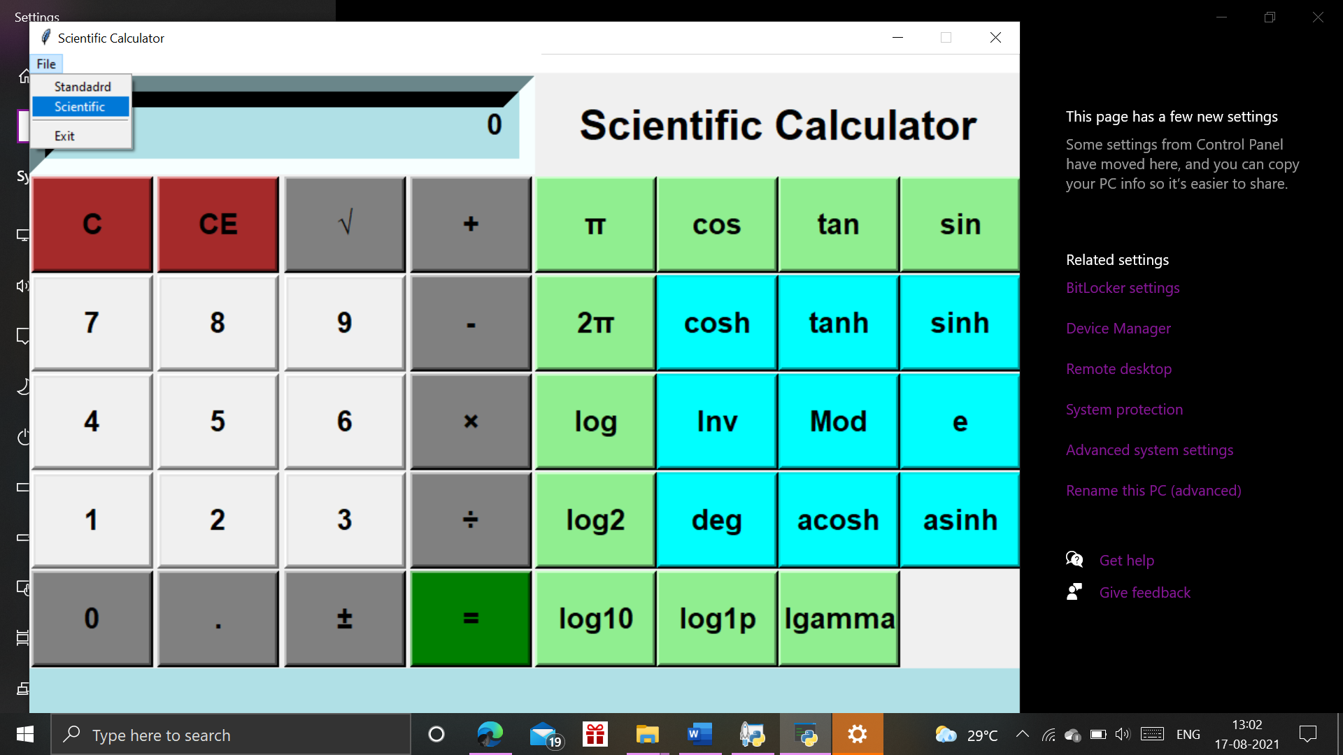
Improvements;
for

Slide 10

Learning Outcomes

Slide 11

Thankyou!

